Slide 1
Unified mentor- machine learning internship project
Animal classification using neural networks
Presentation by
Indumathi Rajendran

Slide 2
agenda
Introduction
Problem Statement / Objective
Dataset Overview
Exploratory Data Analysis (EDA)
Image Preprocessing
Model Building
Model Evaluation
Model Deployment
Frontend Interface (HTML/CSS)
Conclusion

Slide 3
introduction
Animal classification using image data is a significant application of computer vision and deep learning. The primary goal of this project is to automatically recognize and classify animal images into their respective categories based on visual features. By leveraging convolutional neural networks (CNNs) and pretrained deep learning models, the system is trained to learn intricate patterns from image data. The project culminates in a user-friendly web interface, allowing users to upload images and receive predictions instantly, making it suitable for educational, research, and wildlife monitoring applications.

Slide 4
objective
To develop a robust image classification system for animals.
Build and evaluate deep learning models for image recognition.
Deploy the best-performing model using Flask API with a user-friendly web interface.

Slide 5
Dataset overview
The dataset used in this project consists of labeled images of various animal species, organized into separate folders where each folder represents a distinct class. These images vary in background, orientation, and lighting conditions, offering a diverse and realistic set of examples for training. The dataset is divided into training, validation, and testing subsets to ensure effective model training and unbiased evaluation. Before feeding the data into the model, images are resized to a consistent shape, and preprocessing techniques such as normalization and augmentation are applied.

Slide 6
Exploratory data analysis
Exploratory Data Analysis was performed to understand the structure, distribution, and quality of the image dataset. The number of images in each class was visualized to check for any class imbalance that could affect model performance. Sample images from each category were displayed to verify the correctness of labeling and to observe variations in pose, background, and lighting. This initial analysis helped guide preprocessing decisions such as resizing and augmentation, and provided insights into potential challenges the model might face during classification.

Slide 7
Image preprocessing
Image preprocessing is a crucial step in preparing the dataset for training deep learning models. In this project, all images were resized to a fixed dimension to ensure uniformity across the dataset. Pixel values were normalized to a range of 0 to 1 to speed up convergence during training. To improve the model’s robustness and prevent overfitting, data augmentation techniques such as horizontal flipping, rotation, zooming, and shifting were applied. These augmentations artificially increased the size and diversity of the training set, helping the model generalize better to new, unseen images. The dataset was also split into training, validation, and test sets to monitor performance and tune hyperparameters effectively.

Slide 8
Model building
Tried multiple models:
Basic CNN
Pretrained Models: VGG16, ResNet50, MobileNet
Used TensorFlow/Keras with Conv2D, MaxPooling2D, Dense layers.
Fine-tuned pretrained models using transfer learning.

Slide 9
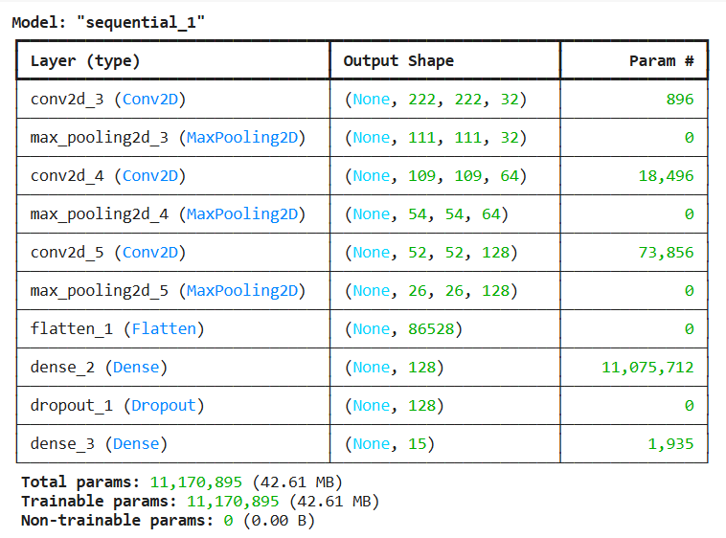
cNN Model summary

Slide 10
Model evaluation
The performance of the animal classification models was evaluated using several key metrics, including accuracy, precision, recall, and F1-score. These metrics provided a comprehensive understanding of the model’s ability to correctly classify images across all animal classes. A confusion matrix was used to visualize the true versus predicted labels, helping identify specific classes where misclassifications were common. Additionally, training and validation accuracy/loss curves were plotted to monitor the learning process and detect issues like overfitting or underfitting.

Slide 11
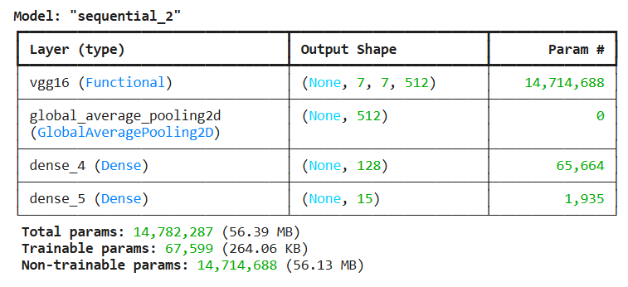
Vgg 16 Model summary

Slide 12
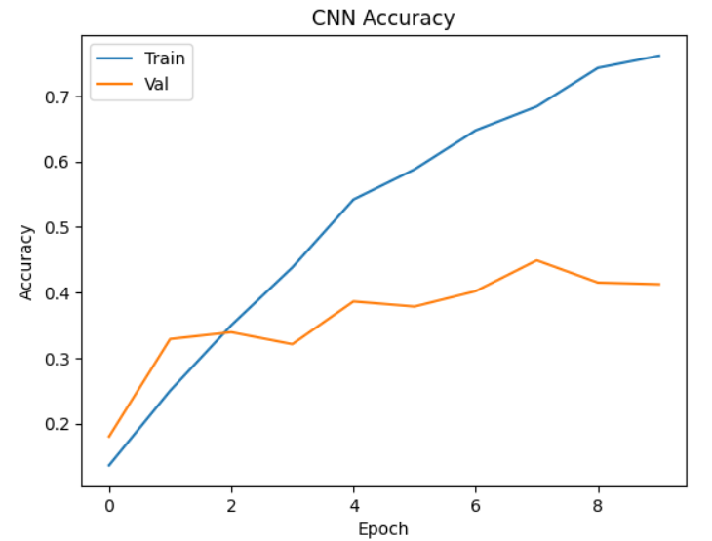
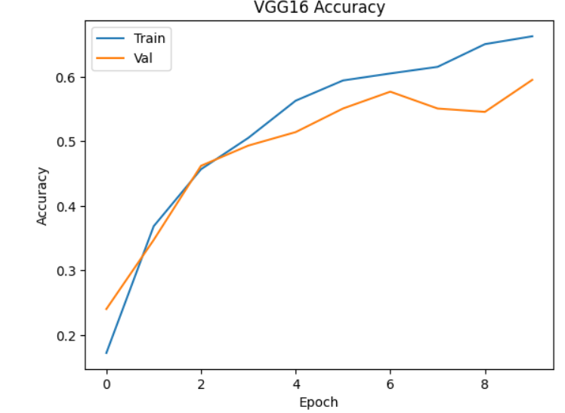
Model comparison

Slide 13
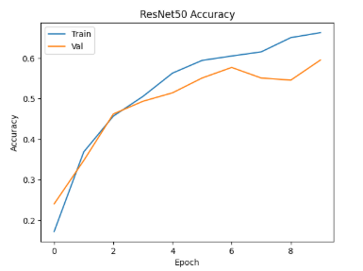
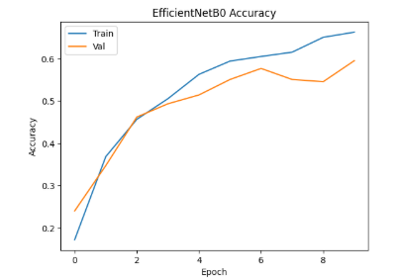
Model comparison

Slide 14
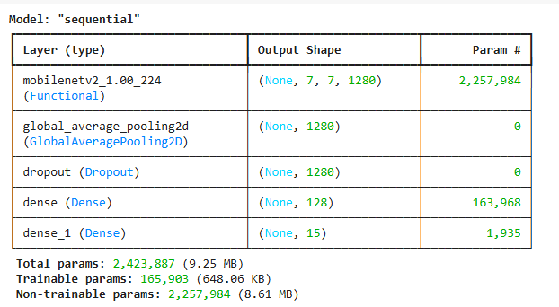
Mobilenet v2 model summary

Slide 15
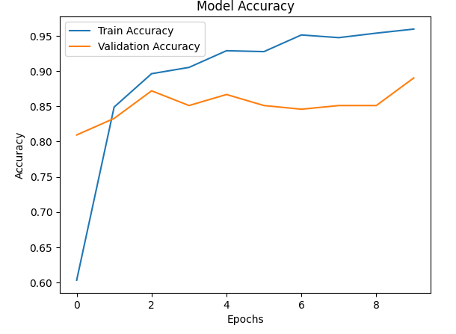
Moblienet v2 performance

Slide 16
Model comparison
Model | Accuracy | Training Time | Remarks
Basic CNN | Moderate | Fast | Lightweight, baseline model
VGG16 | High | Medium | Deeper layers, good generalization
ResNet50 | High | Slower | Best performance, but heavier
MobileNet | Good | Very Fast | Lightweight, good trade-off

Slide 17
Model deployment
The best-performing model was deployed using a Flask-based API to make it accessible through a web interface. The trained model was saved in .h5 format and loaded within the Flask application for real-time inference. A simple and user-friendly HTML/CSS frontend was created, allowing users to upload animal images through a web form. When an image is submitted, it is processed by the backend, which performs the necessary preprocessing and uses the model to predict the animal class. This deployment approach enables seamless integration of the deep learning model into a functional web application, making it easy for end users to interact with the system without requiring any technical knowledge.

Slide 18
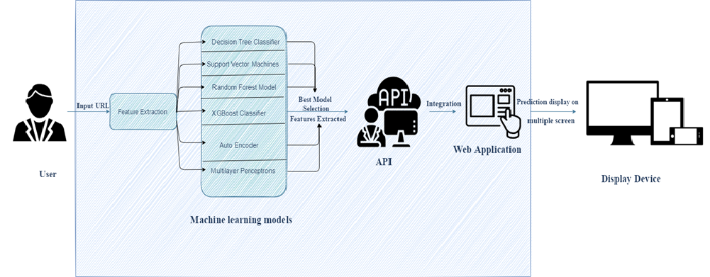
Architectural design and deployment
The trained model was integrated into a Flask web framework for deployment. The model was serialized using joblib and loaded into a Flask API endpoint. A simple HTML/CSS frontend was created to accept user inputs, which are sent to the backend via HTTP POST requests.

Slide 19
Frontend interface
HTML form to upload animal image.
Displays predicted animal name.
CSS used for styling and responsiveness.
Interacts with Flask backend using form POST request.

Slide 20
web application design
1. Web Application Development
Designed a user-friendly, browser-compatible web UI
Enabled input & prediction display
Built using HTML, CSS, JavaScript (or React)
2. Model Integration
Integrated final model into the backend (Flask/Django)
Connected model predictions to the frontend
Ensured real-time detection functionality
3. Deployment & Testing
Deployed web app to a live server
Tested for performance & user feedback
Ensured system stability and speed

Slide 21
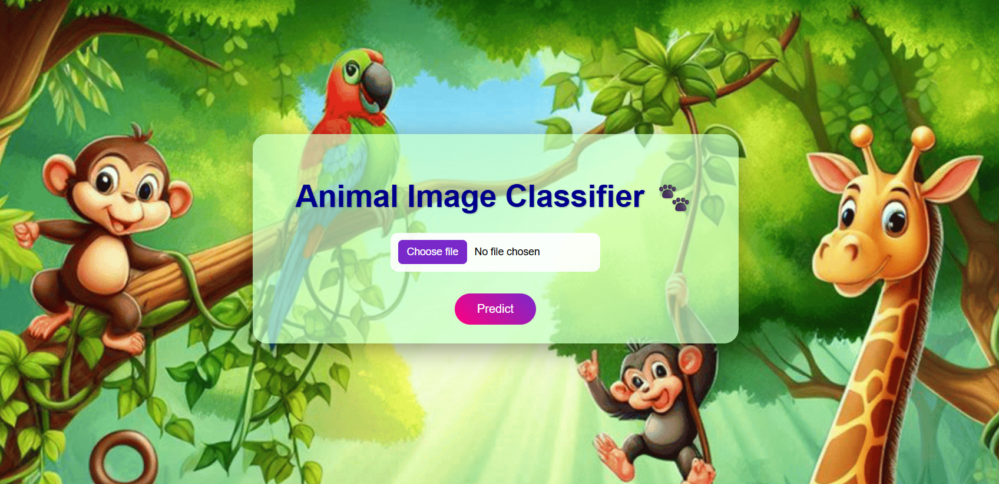
Animal classification WEBAPP

Slide 22
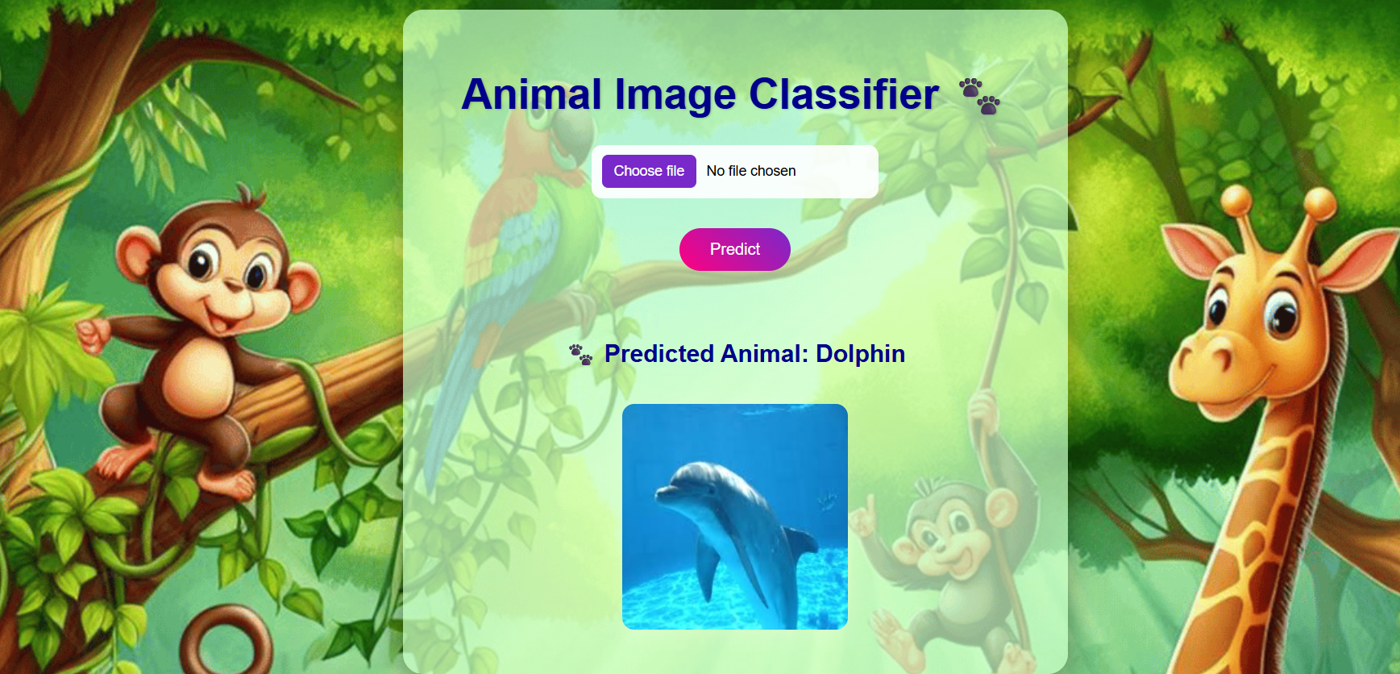
Animal classification WEBAPP

Slide 23
conclusion
The animal classification project successfully demonstrates the application of deep learning in solving real-world image recognition problems. By leveraging convolutional neural networks and pretrained models, the system achieved high accuracy in classifying various animal species. The deployment of the trained model through a Flask API with an interactive HTML/CSS frontend enabled real-time predictions in a user-friendly manner. This project not only showcases the effectiveness of AI in visual tasks but also provides a scalable framework for future enhancements and real-world applications.

Slide 24
Thank you

